Slide 1


egov-team23/IIITB
Chellapriyadarshni
Jyotsana
Kanika Narang
Surabhi Gupta
Tehreem Ansari

Slide 2
Use Case: Hyperlocal citizen satisfaction
Problem - Public Grievances and Redressal - Insights into
Nature of complaints by demographics:
Whether demographics influence grievance redressal
Absence of complaints of specific nature
Method and Tools Used:
We have used R programming for Data Analysis
We have created various charts to represent our Exploratory Analysis of the given data.
For creating charts we have used ‘plotly library’.

Slide 3
Assumptions
Data has been analyzed only for residential area.
User has been divided into three categories based on the area they live in. We are assuming that there is a correlation between income/wealth of the user and the Guidance value of the region he lives in. Similarly for rent case.
High Income: 0.5<= Guidance Value <=1
Low Income: 1< Guidance Value <=1.5
Mid Income: 1.5<= Guidance Value <=2

Slide 4
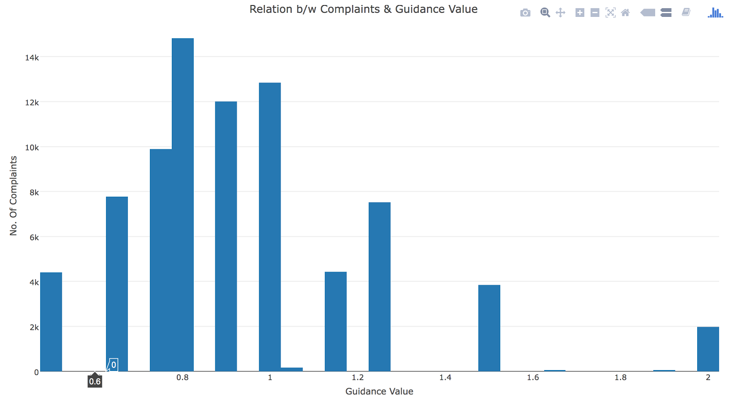
Relation between Complaints and Guidance Value

Slide 5
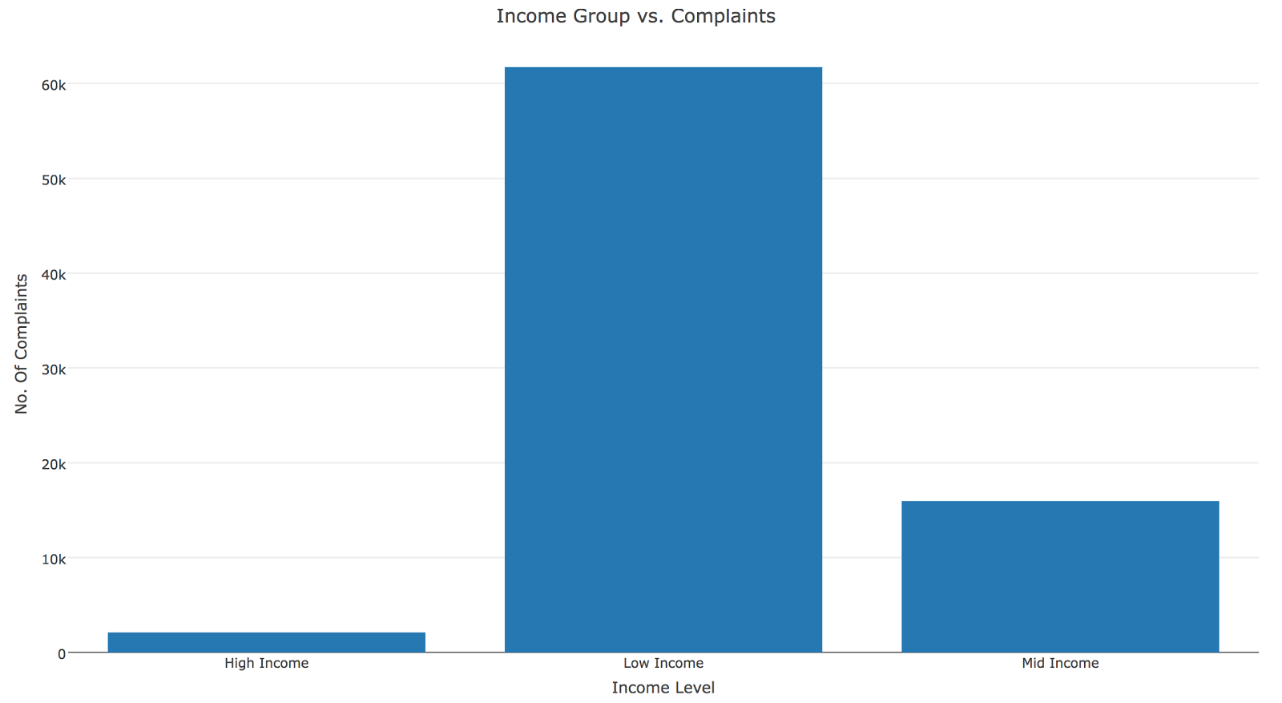
Nature of complaints by demographics

Slide 6
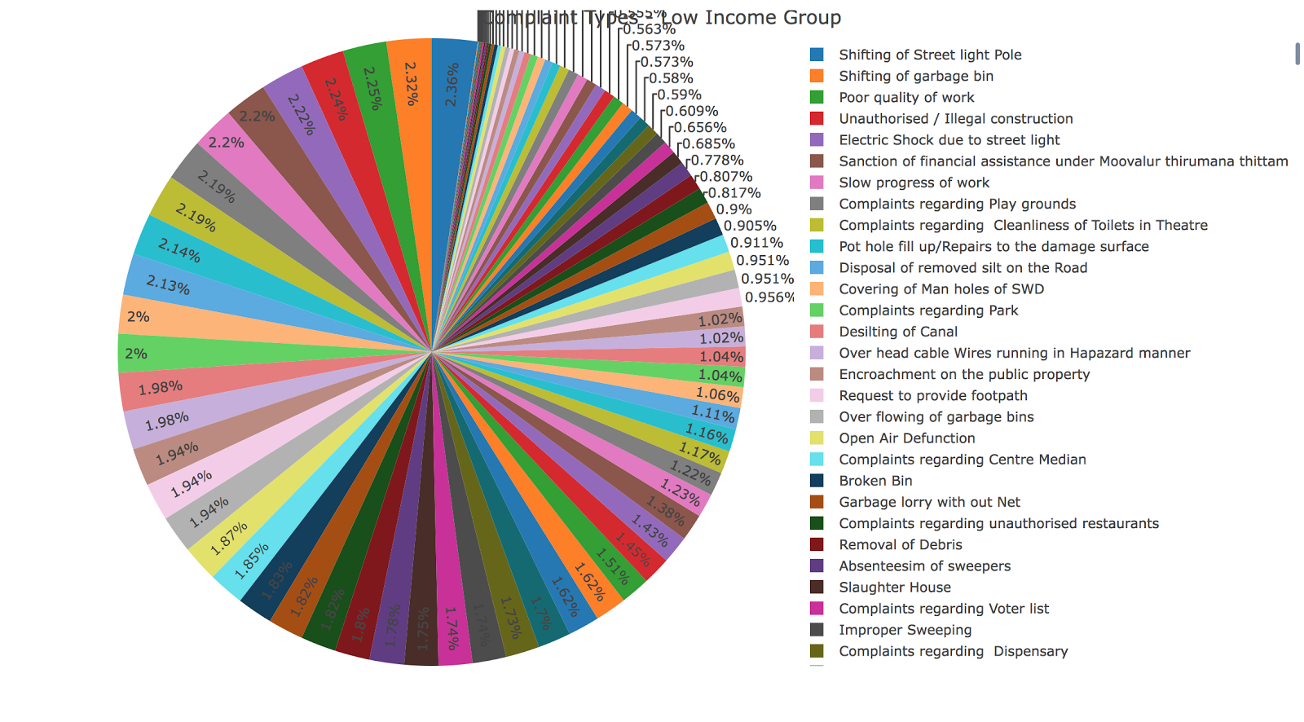
Complaint Types for Low Income Group

Slide 7
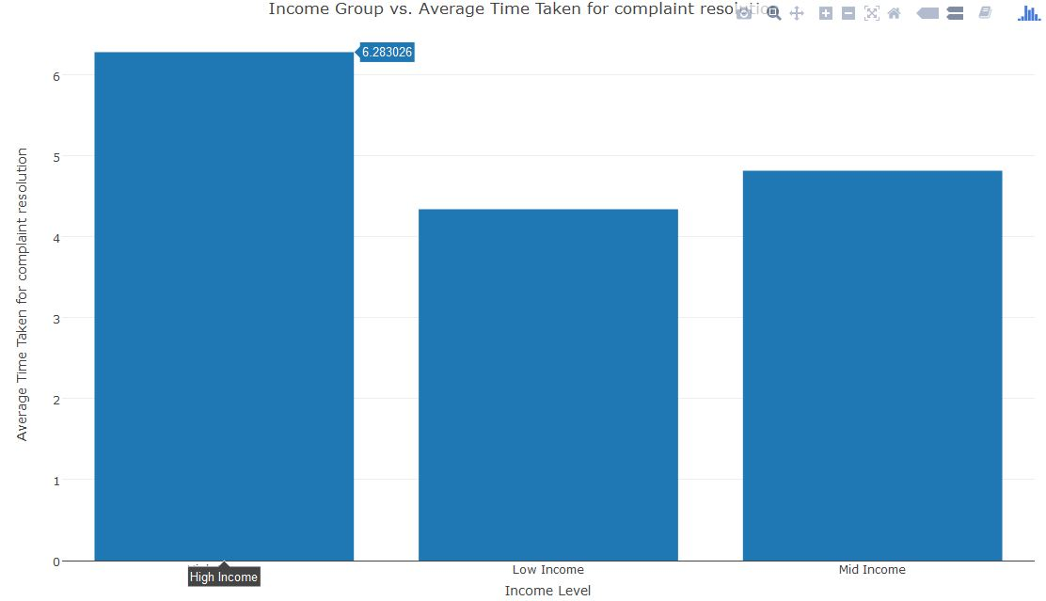
Whether demographics influence grievance redressal

Slide 8
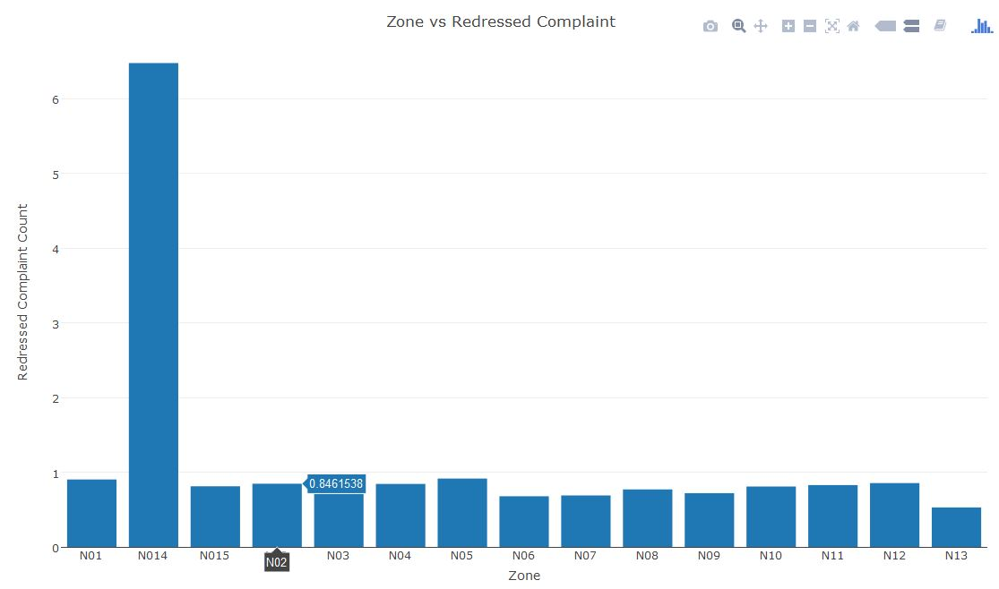
Zone vs Redressed Complaint (based on Is Complaint Redressed?)
N014 is the zone where complaints have been most redressed

Slide 9
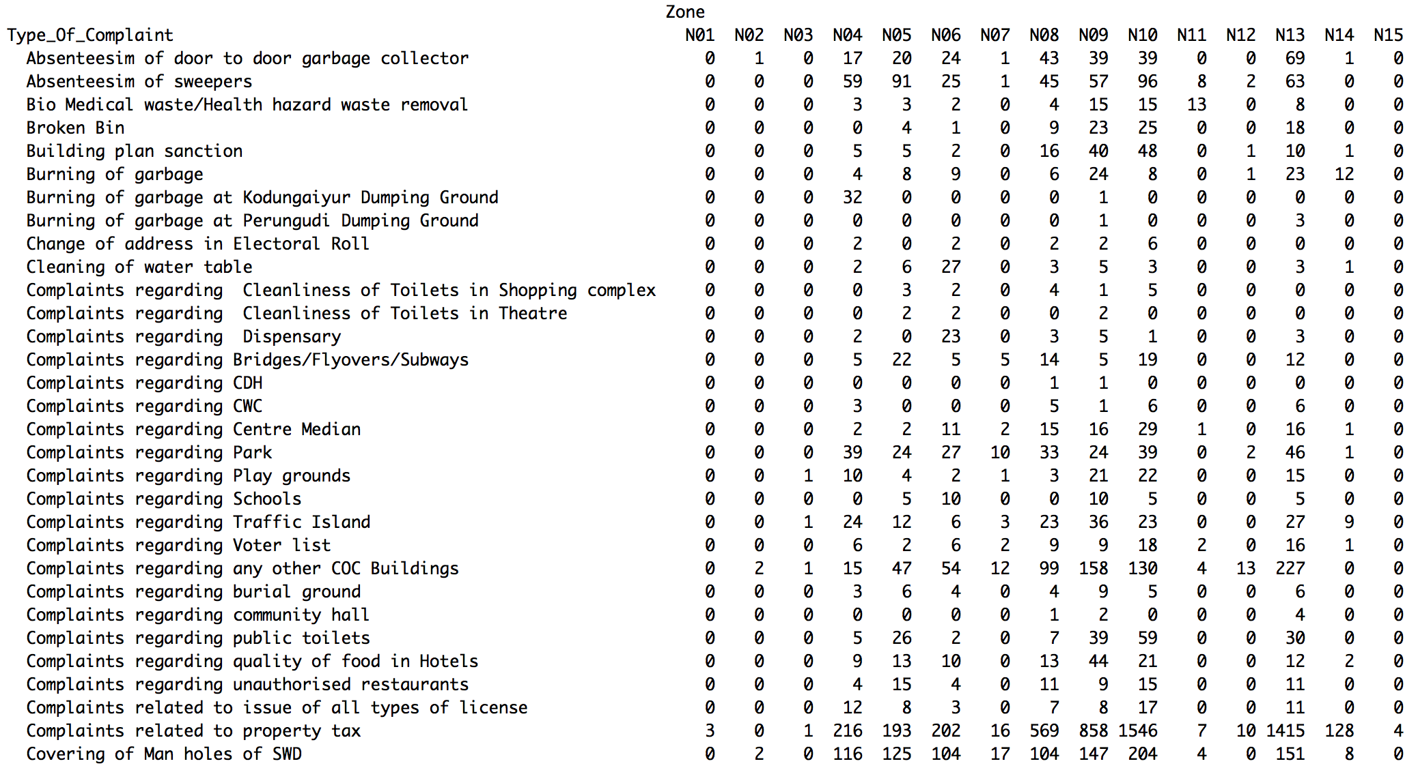
Absence of complaints of specific nature

Slide 10
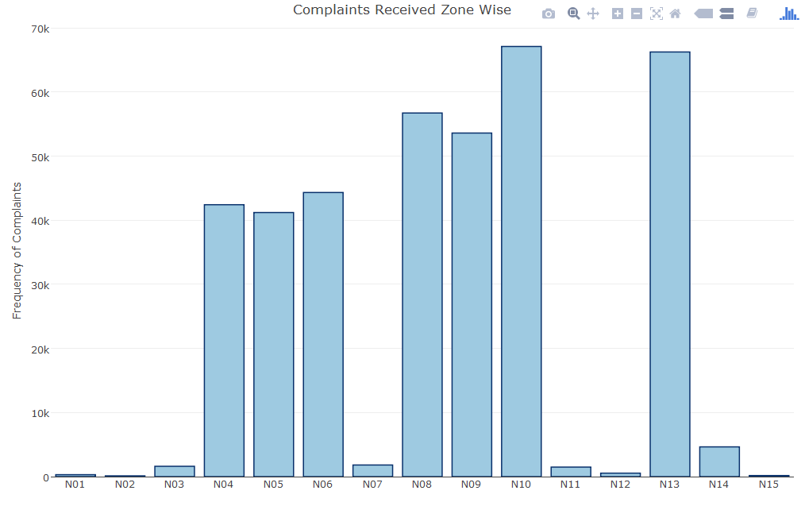
N10 zone have maximum complaints (67.101k)
Zone N15 have least number of complaint (165)

Slide 11
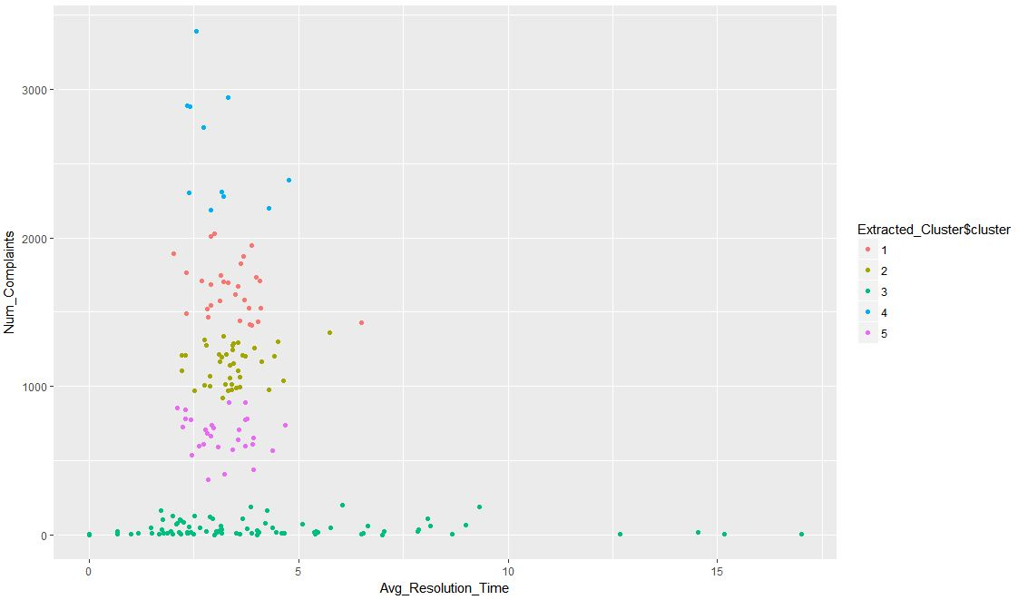
Customer Satisfaction Score at ward level

Slide 12
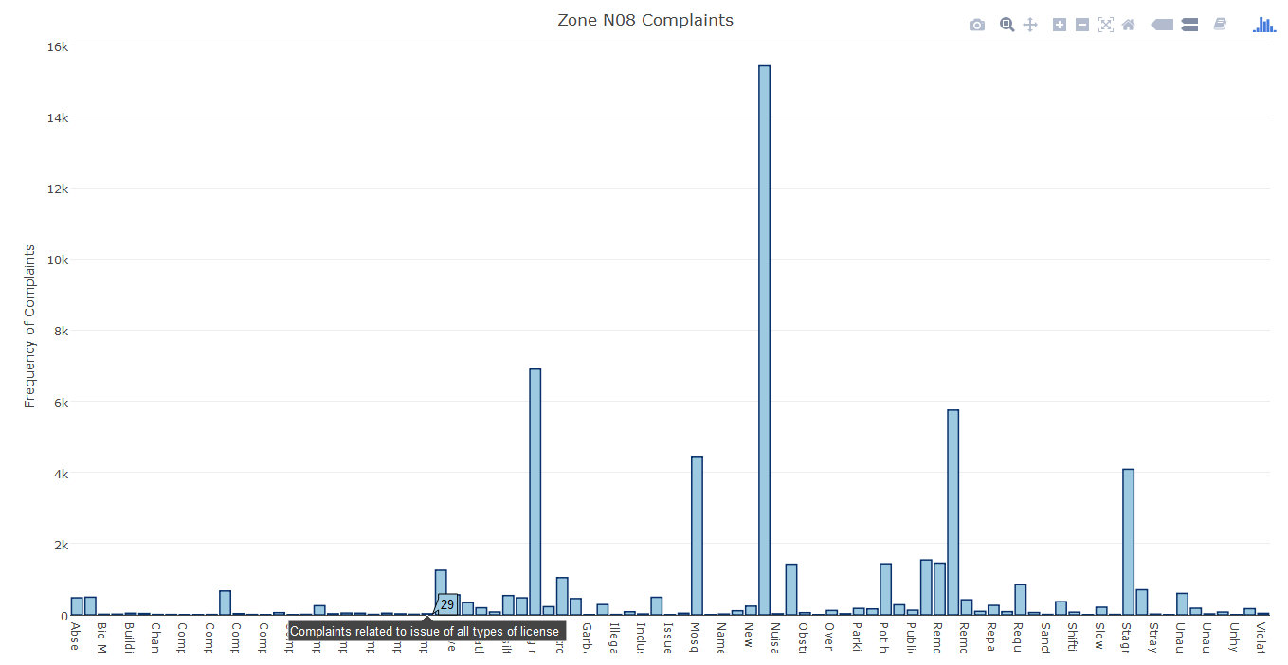
Some More Interesting Results
Complaints Received Zone Wise (Total 15 Zones N01 to N15)

Slide 13
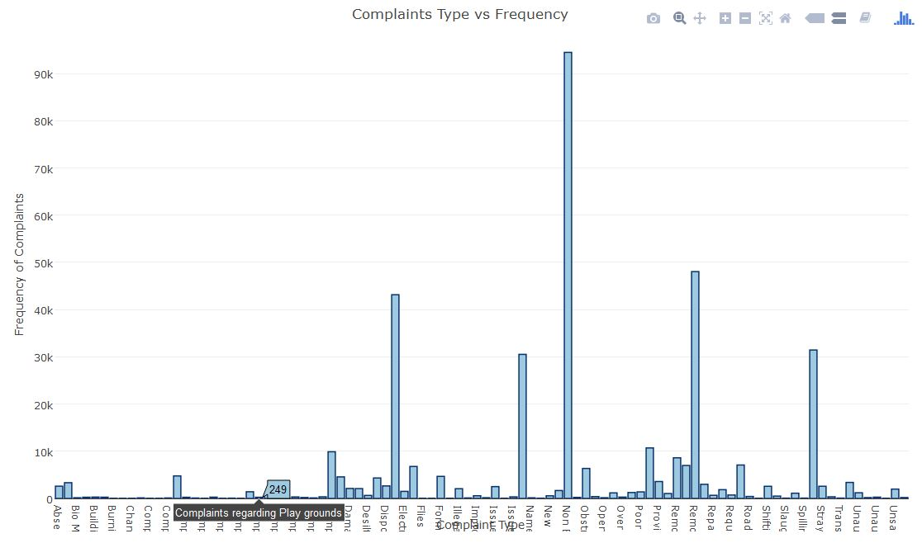
Complaint Type Vs Frequency
Non Burning Street Lights

Slide 14
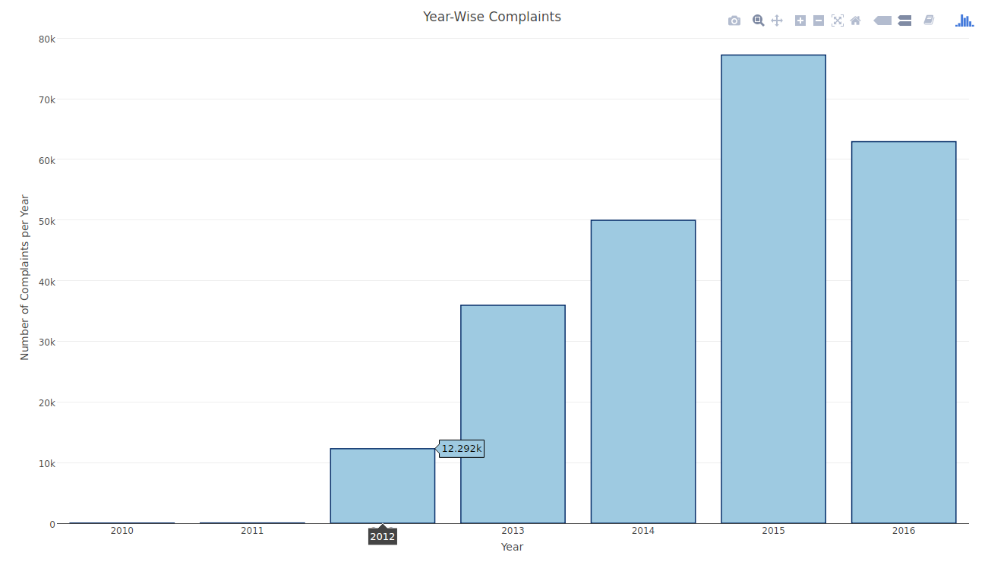
Number of complaints Received in an Year (2010-2016)
2015 got maximum complaints

Slide 15
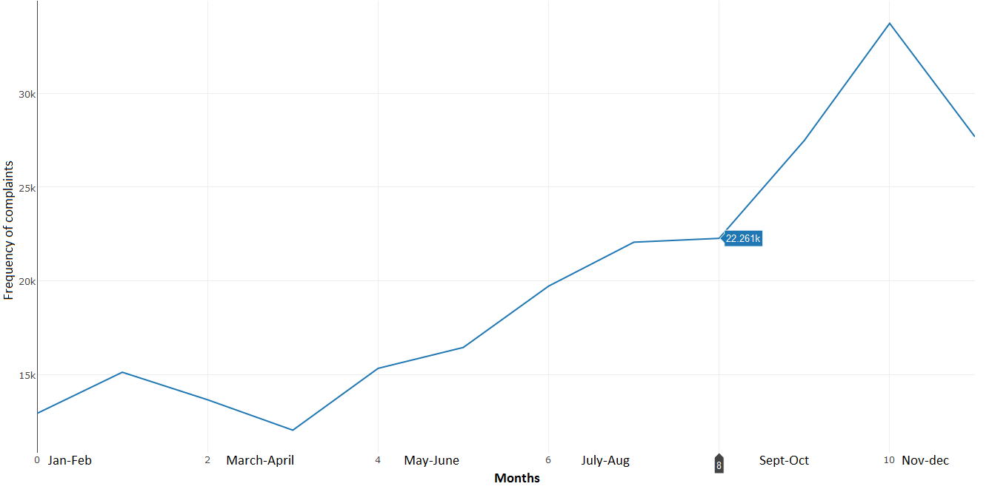
Number of complaints Received in Monthly(Jan, 2010-Dec, 2016)

Slide 16
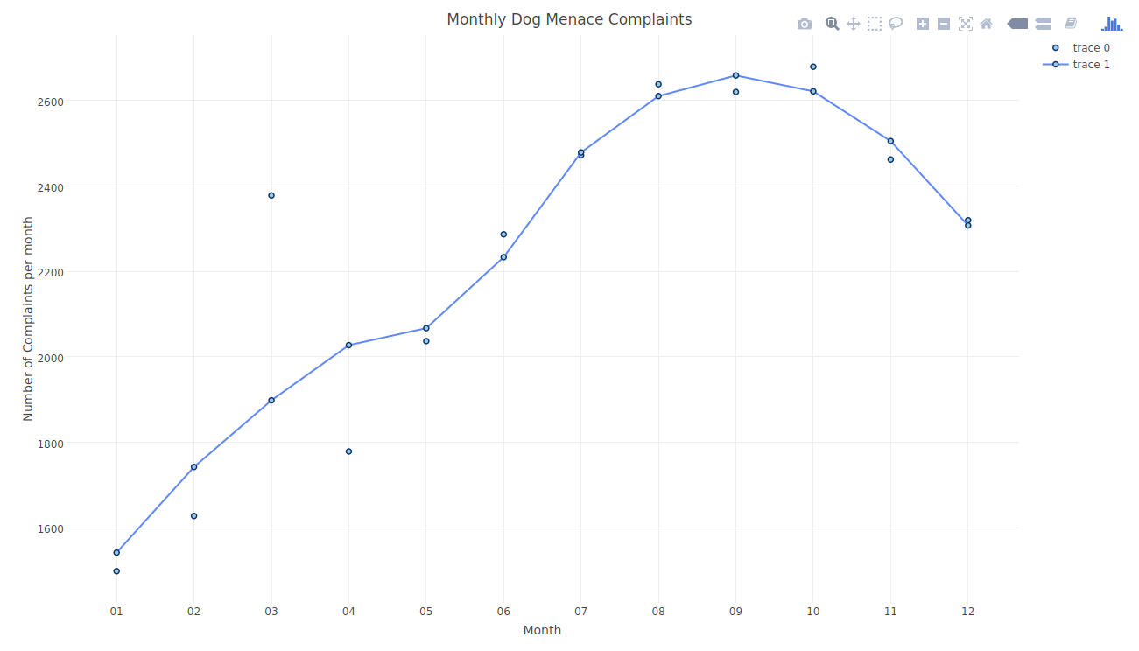
Dog Menance received Month Wise (Jan-Dec)

Slide 17
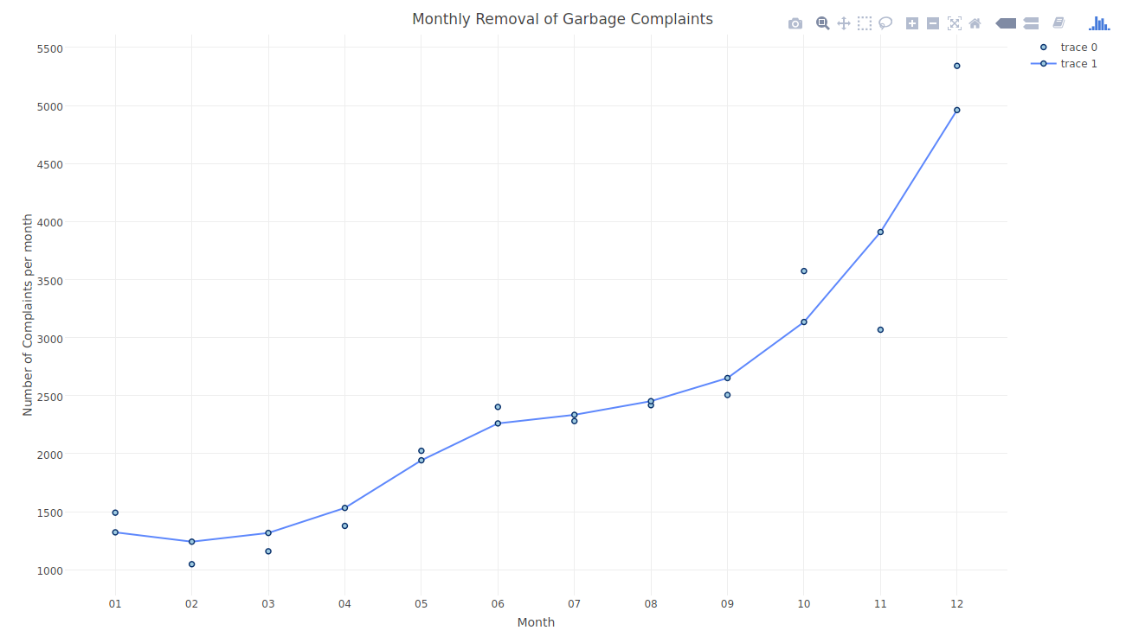
Removal of Garbage Complaint received Month Wise (2010-2016)

Slide 18
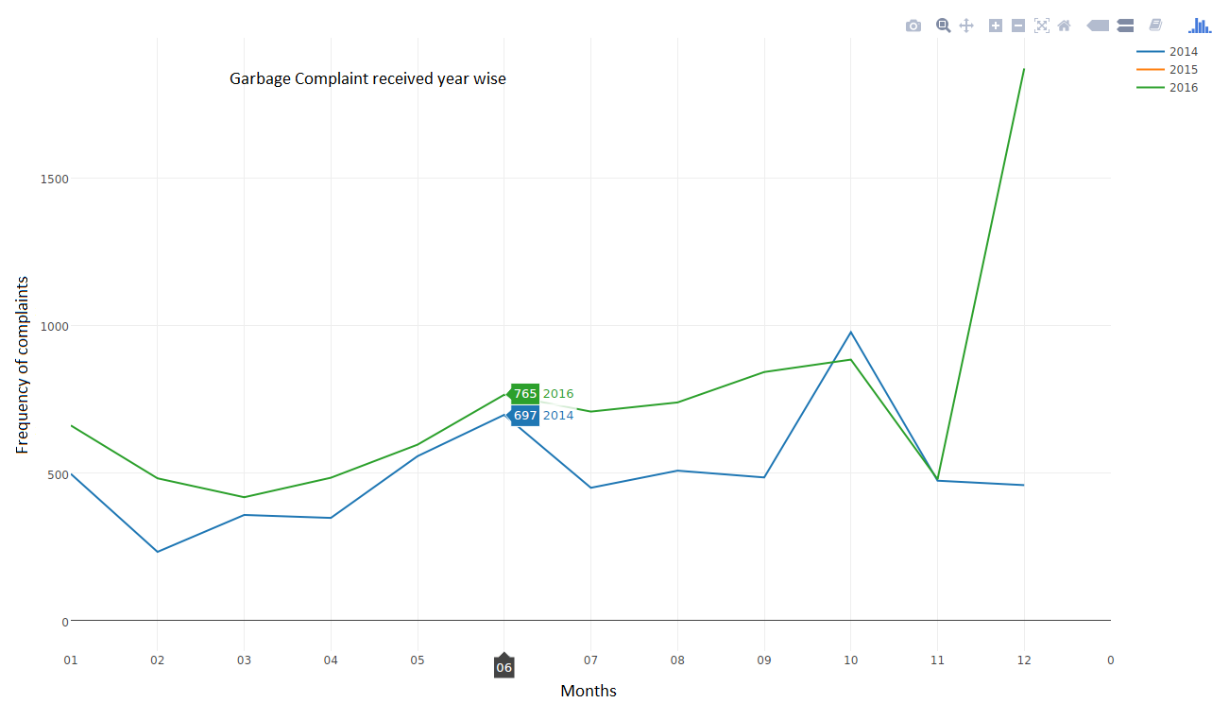
Removal of garbage Complaint for 2014-2016 Year

Slide 19
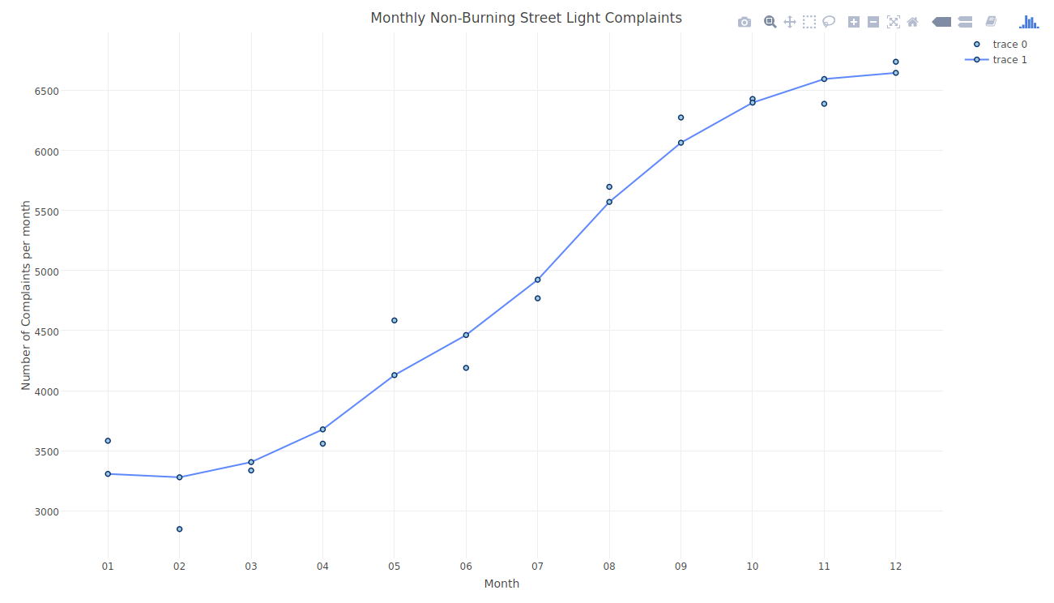
Street light Complaint received Month Wise (Jan, 2010-Dec, 2016)

Slide 20
Result
1). We observed that there were 91 unique Complaint type distributed among 15 Zones.
2). According to our analysis.
Low income group users have registered maximum complaints. This maybe due to the fact that the amenities for high income and average income regions fare better than low ones.
No special relationship found between time taken for grievance redressal and income groups.
Maximum Complaints were registered for Non-Burning Street Lamps.
Number of complaints registered over the year has risen but there was a small dip in the year 2016
We can do time series analysis on each complaint type to find the seasonal trend. This can be useful to be prepared to tackle the upcoming situation by the concerned department.

Slide 21
Customer Satisfaction Score
This is dependent on following variables: Number of Complaints of the Ward and Days taken to redress the complaints.
Since we didn’t have labelled scores we built a model to evaluate Groups of Customer having similar score using K-Means Clustering Algorithm.

